Slide 1
0/1 Knapsack problem using Dynamic Programming

Slide 2
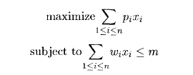
0/1 Knapsack Problem
Problem
Given ‘n’ objects and a knapsack or bag. Object ‘ i’ has a weight w_{i} and the
Knapsack has a capacity ‘m’.
0/1 Knapsack Problem:
Items are indivisible; you either take an item or not
x _{i} = 0 or 1

Slide 3
0/1 Knapsack Problem
brute-force approach
Let’s first solve this problem with a straight forward algorithm
Since there are ‘n’ items, there are 2^{n} possible combinations of items.
We go through all combinations and find the one with maximum value and with total weight less or equal to m
Running time will be O(2^{n} )
x₁ | x₂ | x₃
0 | 0 | 0
0 | 0 | 1
0 | 1 | 0
0 | 1 | 1
1 | 0 | 0
1 | 0 | 1
1 | 1 | 0
1 | 1 | 1
Example :
Let us consider n=3 objects/items. Solution vector will be (x₁,x₂,x₃)
The possible solution vectors will be …….
Can we do better?
Yes, with an algorithm based on dynamic programming

Slide 4
0/1 Knapsack Problem
Step 1: Decompose the problem into smaller problems.
A solution vector for the knapsack problem is x₁,x₂,…x_{n} where n items exist.
Possible assignment for x_{i} will 0 or 1.
Let us assume that decisions on the x_{i} are made in the order x_{n},x_{n-1},... ,x₁.
A decision on x_{n}, will be in one of two possible states:
The capacity remaining in the knapsack is m and no profit has accrued or
The capacity remaining is m - w_{n} and a profit of p_{n} has accrued.
the remaining decisions x_{n-1},…..x₁ must be optimal with respect to the problem state resulting from the decision on x_{n}.
Otherwise, x_{n},... ,x₁ will not be optimal.
Hence, the principle of optimality holds

Slide 5
0/1 Knapsack Problem
1
be the optimal solution to KNAP(1,n,m)
We can generalize the equation 1 for KNAP(1,i,y) as
2
Then compute f₁, f₂, … f_{n} by using equation 2
Where f₀(y)= 0 for all y’s and f_{i}(y)=- ∞ , y<0
Here f_{i}(y) need to computed for integer y where 0 ≤ y ≤m
Example: n=3, m=5
Need to compute f₁, f₂, f₃
For each f₁ we need to compute f₁(1),f₁(2),f₁(3),f₁(4),f₁(5) as f₀(y)= 0 for all y’s and f_{i}(y)=- ∞ , y<0 need not to be computed.
Similarly for f₂, f₃

Slide 6
0/1 Knapsack Problem
We construct an array B[0..n ,0..m]
Each entry B[i,y] will be
The entry B[n,m] will be gives
maximum profit. Ie optimal solution

Slide 7
0/1 Knapsack Problem
Step 2: Recursively define the value of an optimal solution in terms of solutions to smaller problems.
According to this f₀(y)= 0 for all y’s and f_{i}(y)=- ∞ , y<0
All entries in B[0,y]=0 for all y’s where 0 ≤ y ≤m and
B[i,y]= -∞ for y < 0
Each entry B[i,y] will be
B[i,y] = max( B[i-1,y], B[i-1,y-w_{i}]+p_{i} )
for 1≤ i ≤n, 0 ≤y≤ m

Slide 8
0/1 Knapsack Problem
Step 3: Compute the value of an optimal solution, typically in a bottom-up fashion using a table structure.
First compute B[0,y] = 0 for all 0 ≤ y ≤m
B[i,y] | y=0 | 1 | ……… | m
i=0 | 0 | 0 | 0 | 0
1
2
3
……
N

Slide 9
0/1 Knapsack Problem
Step 3: Compute the value of an optimal solution, typically in a bottom-up fashion using a table structure.
First compute B[0,y] = 0 for all 0 ≤ y ≤m
Then compute the values of B[i,y] row by row by using
B[i,y] = max( B[i-1,y], B[i-1,y-w_{i}]+p_{i} )
for 1≤ i ≤n, 0 ≤y≤ m
B[i,y] | y=0 | 1 | ……… | m
i=0 | 0 | 0 | 0 | 0
1
2
3
……
N

Slide 10
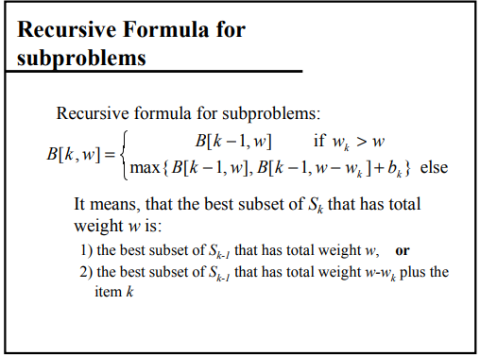
0/1 Knapsack Problem
Finding subproblem solution S_{k .} In S_{k-1} ={1,2,…,k-1} are included
Profit ‘p’ is represented as ‘b’
In S_{k} ={1,2,..k-1}
In S_{k} ={1,2,..k}

Slide 11
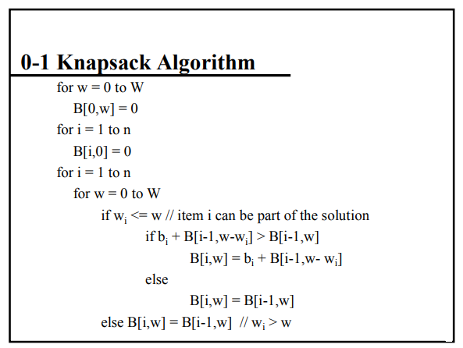

Slide 12
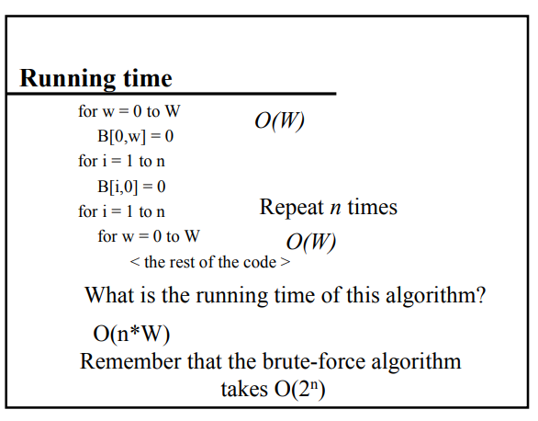

Slide 13
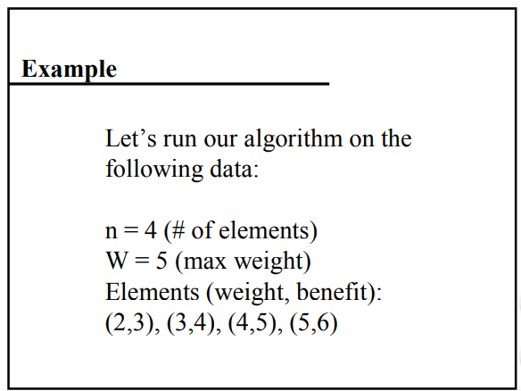

Slide 14
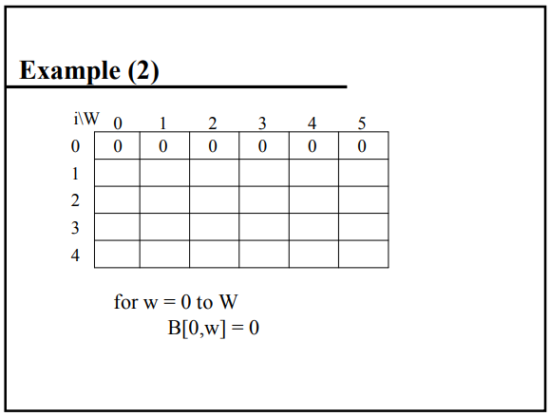

Slide 15
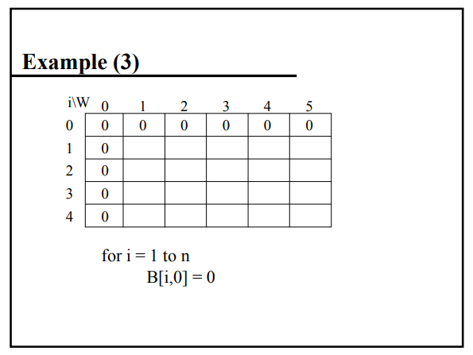

Slide 16
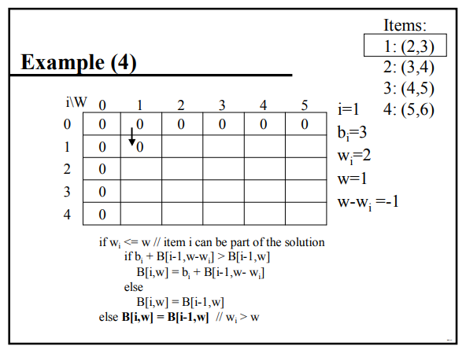

Slide 17
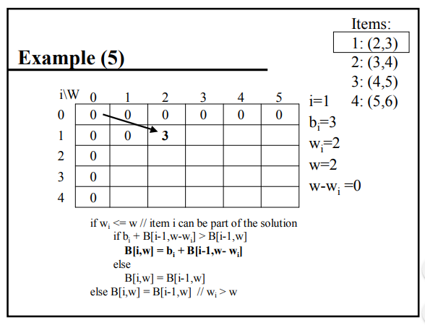

Slide 18
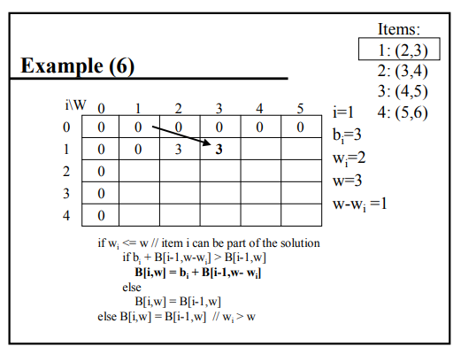

Slide 19
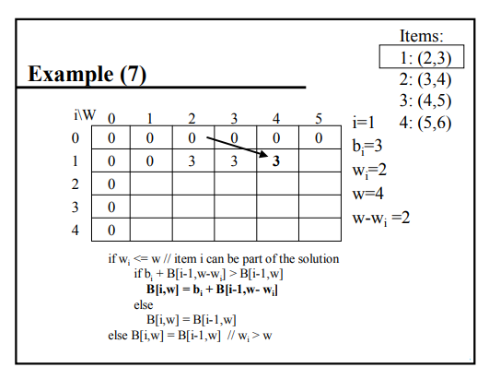

Slide 20
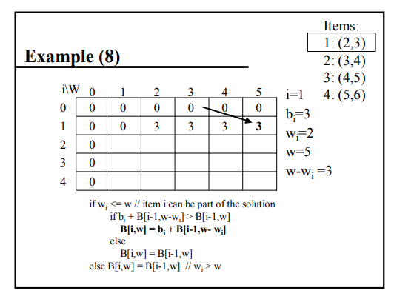

Slide 21
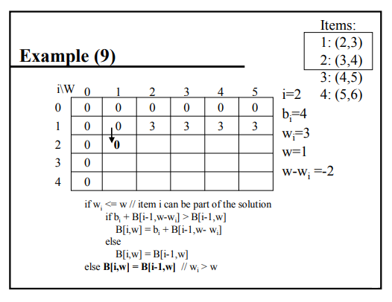

Slide 22
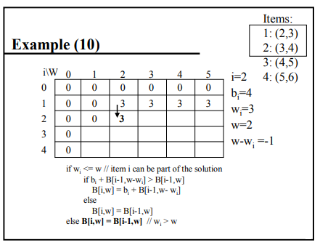

Slide 23
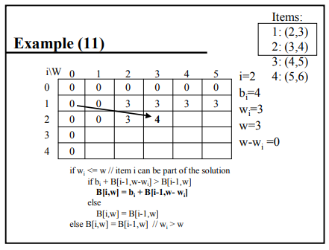

Slide 24
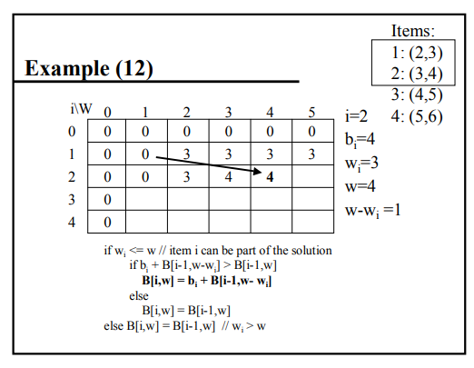

Slide 25
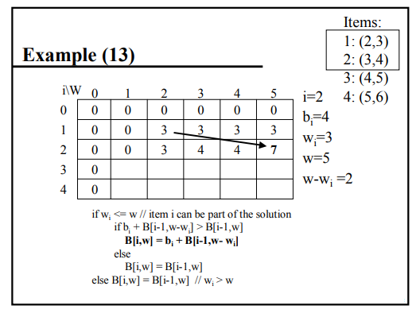

Slide 26
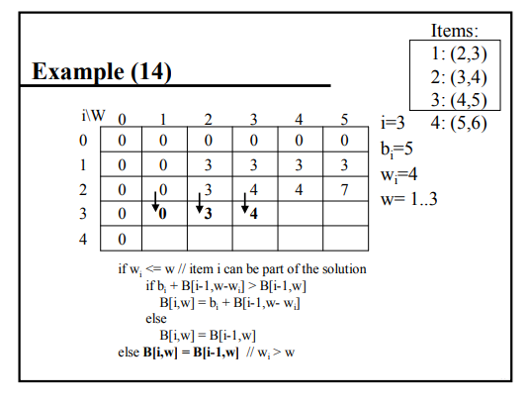

Slide 27
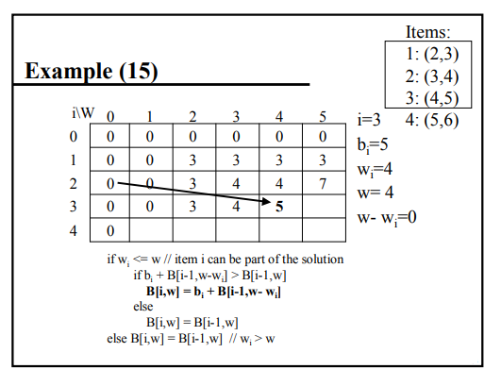

Slide 28
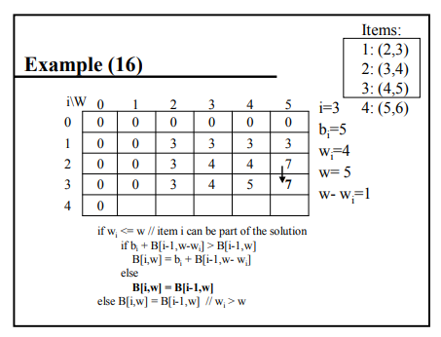

Slide 29
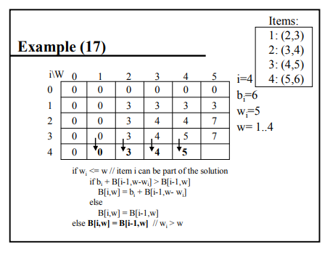

Slide 30
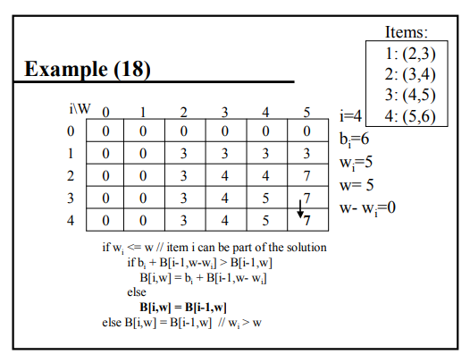

Slide 31
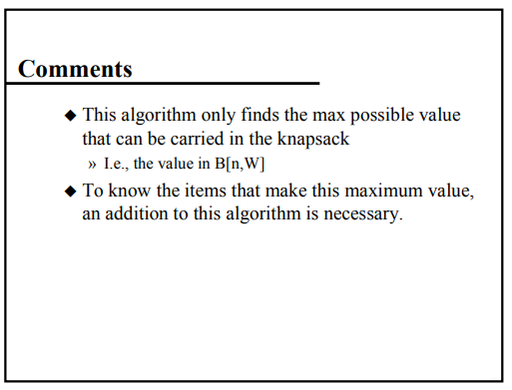

Slide 32
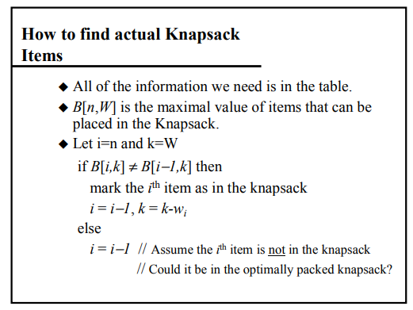

Slide 33
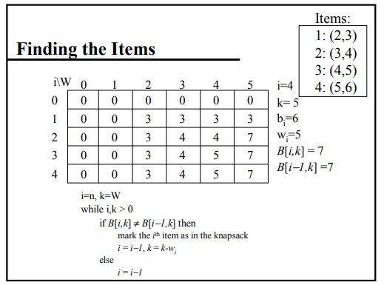

Slide 34
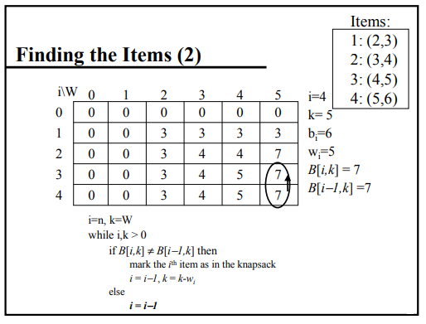

Slide 35
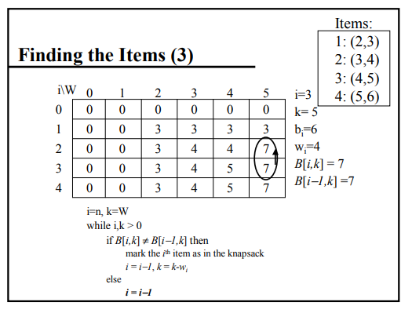

Slide 36
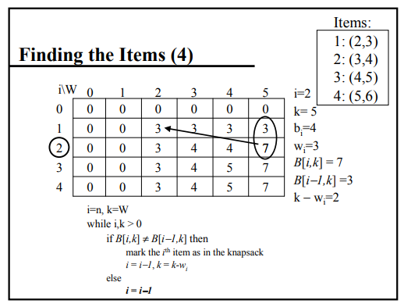

Slide 37
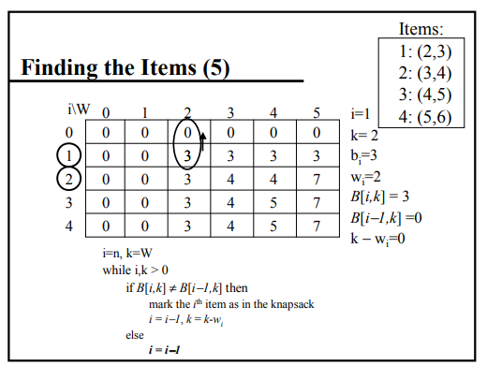

Slide 38
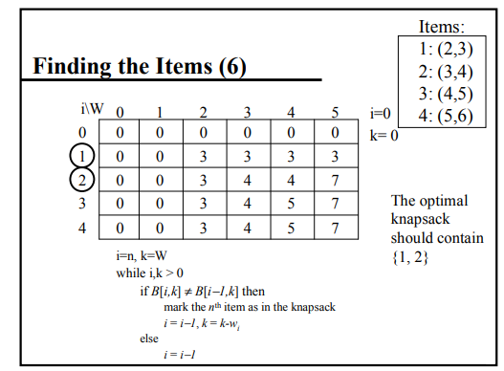

Slide 39
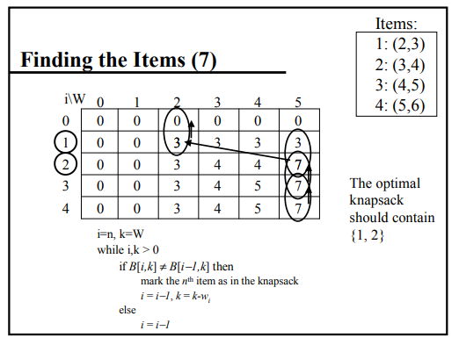

Slide 40
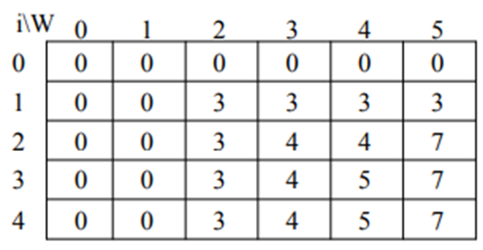
0/1 Knapsack Problem
if weights w_{i} are real numbers or ‘m’ value is large.
Then calculating f_{i}(y)’s will be difficult.
We can go with an alternative method using ordered set.
In the table all f_{i}(y) values are in ascending step function.
Ie 0=y₁<y₂<….<y_{k} such that f_{i}(y₁)<f_{i}(y₂)<…..f_{i}(y_{k})
We need to compute only f_{i}(y_{j}) values , 1≤ j ≤k
We use the ordered set S^{i}={ ( f(y_{j}) , y_{j} ) | 1≤ j ≤k} to represent f_{i}(y)
Each member of S^{i} is a pair (P, W) where P= f_{i}(y_{j}) and W = y_{j}

Slide 41

0/1 Knapsack Problem
We use the ordered set S^{i}={ ( f(y_{j}) , y_{j} ) | 1≤ j ≤k} to represent f_{i}(y)
Each member of S^{i} is a pair (P, W) where P= f_{i}(y_{j}) and W = y_{j}
Initially S⁰={ ( 0,0)}
We can compute S^{i+1} from S^{i} by first computing $S_{}^{i}₁$
Purge Operation or Dominance Rule
If S^{i+1} contains two pairs (P_{j},W_{j}) and (P_{k},W_{k}) such that P_{j} ≤ P_{k} and W_{j} ≥ W_{k} then discard (P_{j},W_{j})

Slide 42
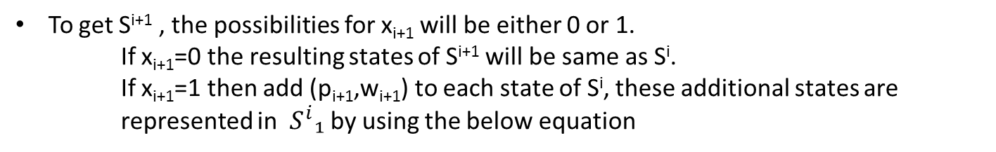
0/1 Knapsack Problem
If ‘n’ items 2^{n} possibilities for x₁,x₂,….x_{n}
Let S^{i} represents 2^{i} decision sequences for x₁,….x_{i}
Each state in S^{i} refers to a pair(P_{j} ,W_{j} ) W_{j} total weight of the objects included in the knapsack and P_{j} profit of all those included objects
To get S^{i+1} , the possibilities for x_{i+1} will be either 0 or 1.
If x_{i+1}=0 the resulting states of S^{i+1} will be same as S^{i}.
If x_{i+1}=1 then add (p_{i+1},w_{i+1}) to each state of S^{i}, these additional states are represented in $S_{}^{i}₁$ by using the below equation
Now merge S^{i} and ${ S}_{ }^{i}₁$ to get S^{i+1}
This process should be repeated to calculate S⁰,S¹,S²,……S^{n}

Slide 43

















0/1 Knapsack Problem
Purge Operation
If S^{i} contains (P_{j},W_{j}) and (P_{k},W_{k}) such that P_{j} ≤ P_{k} and W_{j} ≥ W_{k} then discard
(P_{j},W_{j})
Initial Step
Add third item to S² to generate
Add first item to S⁰ to generate
Merge & to get
Now Merge and to generate
S³={(0,0),(1,2),(2,3),(3,5),(5,4),(6,6),(7,7), (8,8)}
Apply purge rule
Apply purge rule
Add Second item to S¹ to generate
Sets (P_{j},W_{j})= (3,5) & (P_{k},W_{k})= (5,4) 3<5 and 5>4 then discard (3,5) in S³
Merge & to get
Set (7,7) and (8, 9) are discarded because its weight is exceeding the knapsack capacity m
Apply purge rule

Slide 44
0/1 Knapsack Problem
Now after Calculating S⁰,S¹,S²,……S^{n} we need to generate the solution vector(x₁,x₂,….x_{n})
(P1,W1) in the last tuple S^{n}
If (P1,W1) ε S^{n-1} then set x_{n}= 0
If (P1,W1) ∉ S^{n-1} then (P1-p_{n}, W1-w_{n}) ε s^{n-1} then set x_{n}=1
S³={(0,0),(1,2),(2,3),(5,4),(6,6)}
(6,6) ∉ S² (6-5,6-4)=(1,2) ε S² x₃ =1
(1,2) ε S¹ x₂ =0
(1,2) ∉ S⁰ (1-1,2-2)=(0,0) ε S⁰ x₁ =1

Slide 45
Alternatie Approach to SolBe 0/1 Knapsack
Merge Operation
S^{i-1} U S₁^{i-1}
Purge Operation
If S^{i} contains (P_{j},W_{j}) and (P_{k},W_{k}) such that P_{j} ≤ P_{k} and W_{j} ≥ W_{k} then discard
(P_{j},W_{j})

Slide 46
References
http://www.es.ele.tue.nl/education/5MC10/Solutions/knapsack.pdf

Slide 47
Do this problem using tabulation method

Slide 48
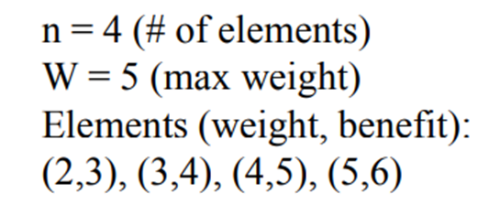
Do this problem using Ordered Set method

